Slide 1
Music Discovery and Perfomance Estimation App
The RocknRolla
Adarsh Goyal
Anand Deshmukh
Anurag soni
Meena kewlani
Yash ambegaokar

Slide 2
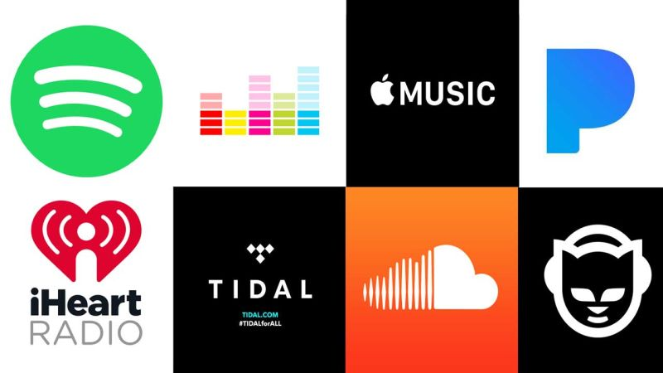
Business Problem
Help users discover songs based on their input, using the app’s recommendation engine
Facilitate artists/music producers in developing a song so that it may meet metrics of commercial success and user patronage

Slide 3
Analytics Problem
Recommendation Engine
Assistance in developing songs
Classification of songs in one of four genres:
Workout
Party
Dinner
Sleep
Compute the relative rating of a song, customized for a given user
Use relative ratings to predict list of songs a user might like based on given input
Predict how a song with specific attributes would perform as per the metrics explained

Slide 4
Sources of Data from Kaggle
Spotify Song attributes https://www.kaggle.com/geomack/spotifyclassification
Audio Features for Playlist Creation https://www.kaggle.com/aniruddhaachar/audio-features
Spotify's Worldwide Daily Song Ranking https://www.kaggle.com/edumucelli/spotifys-worldwide-daily-song-ranking

Slide 5
“Spotify Song Attributes” dataset
Main Features
Acoustic-ness
Dance-ability
Liveness
Energy
Speech-iness
Song_title
Artist

Slide 6
Data Manipulation
Classification of the 2000+ songs from “Spotify Song Attributes” dataset to one of four genres - Workout, Party, Dinner and Sleep:
Reason: To add the “Spotify Song Attributes” dataset to the “Audio Features for Playlist Creation” dataset
How: Used “Supervised Classification” – Random Forrest model for classification
Assumption: Songs with similar musical attributes will fall within the same genre of music
Appending and Joining of Datasets:
Append the “Audio Features for Playlist Creation” dataset to “Spotify Song attributes”
Inner join the “Spotify's Worldwide Daily Song Ranking” dataset to the appended dataset

Slide 7
Data Manipulation (contd.)
Building user’s playlist and listening habits data
Need:
Lack of access to Spotify’s user data
To develop recommendation engine based on user’s past preferences and playlist history
How: Random generation of 100 users’ data to generate the following information:
Song heard/unheard
Number of times a song is played
Percentage length of the song the user usually listens to
Number of days on user’s playlist
Assumptions:
Song heard/unheard – Assumed 30% of songs are heard
Other metrics – Skewed normal distribution

Slide 8
Methodology and Method Selection
Genre Classification Analytics Problems
Supervised Classification – Random forest model
Package: randomForest
Test and Train datasets (70:30)
To build enterprise level functionalities
K-means clustering : To cluster songs based on attributes
Fuzzy clustering: To locate probability of a song falling within a cluster
Package: fclust

Slide 9
What the App offers: Functionality and GUI
Recommendation Engine
Assistance in developing songs
Recommendation engine for users:
Genre
Heard/Unheard songs
Surprise me section: Unheard songs are suggested
Use attributes of songs and list of top 200 songs per region - per day to predict:
Number of times the song would be played
The percentage length of the song that would be heard by users
Number of days the song would be on a user’s playlist
Number of days in top 200 chart, per region
Number of streams per region per day, for the lifetime of a song

Slide 10
The way forward
How do we improve our app?

Slide 11
Thank You

